Slide 1
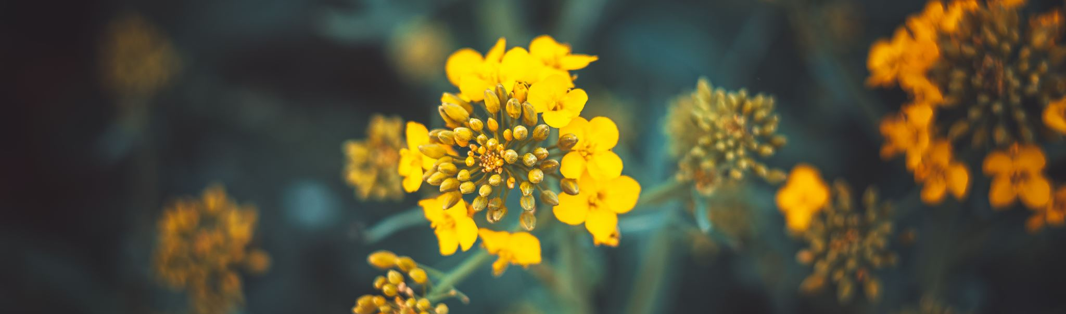
The Beauty of Flowers: Nature’s Masterpieces
An exploration of floral diversity and beauty

Slide 2
Introduction to Flowers
Flowers are the reproductive structures of flowering plants (angiosperms).
They are known for their beauty, colors, and fragrances, attracting pollinators and playing a vital role in ecosystems.

Slide 3
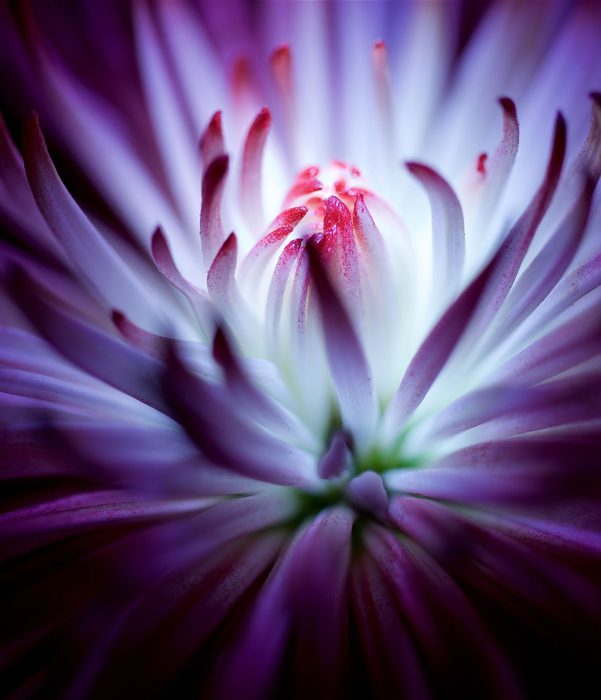
Anatomy of a Flower
Key parts of a flower include:
Petals: Attract pollinators.
Sepals: Protect the flower bud.
Stamen: Male reproductive part.
Pistil: Female reproductive part.

Slide 4
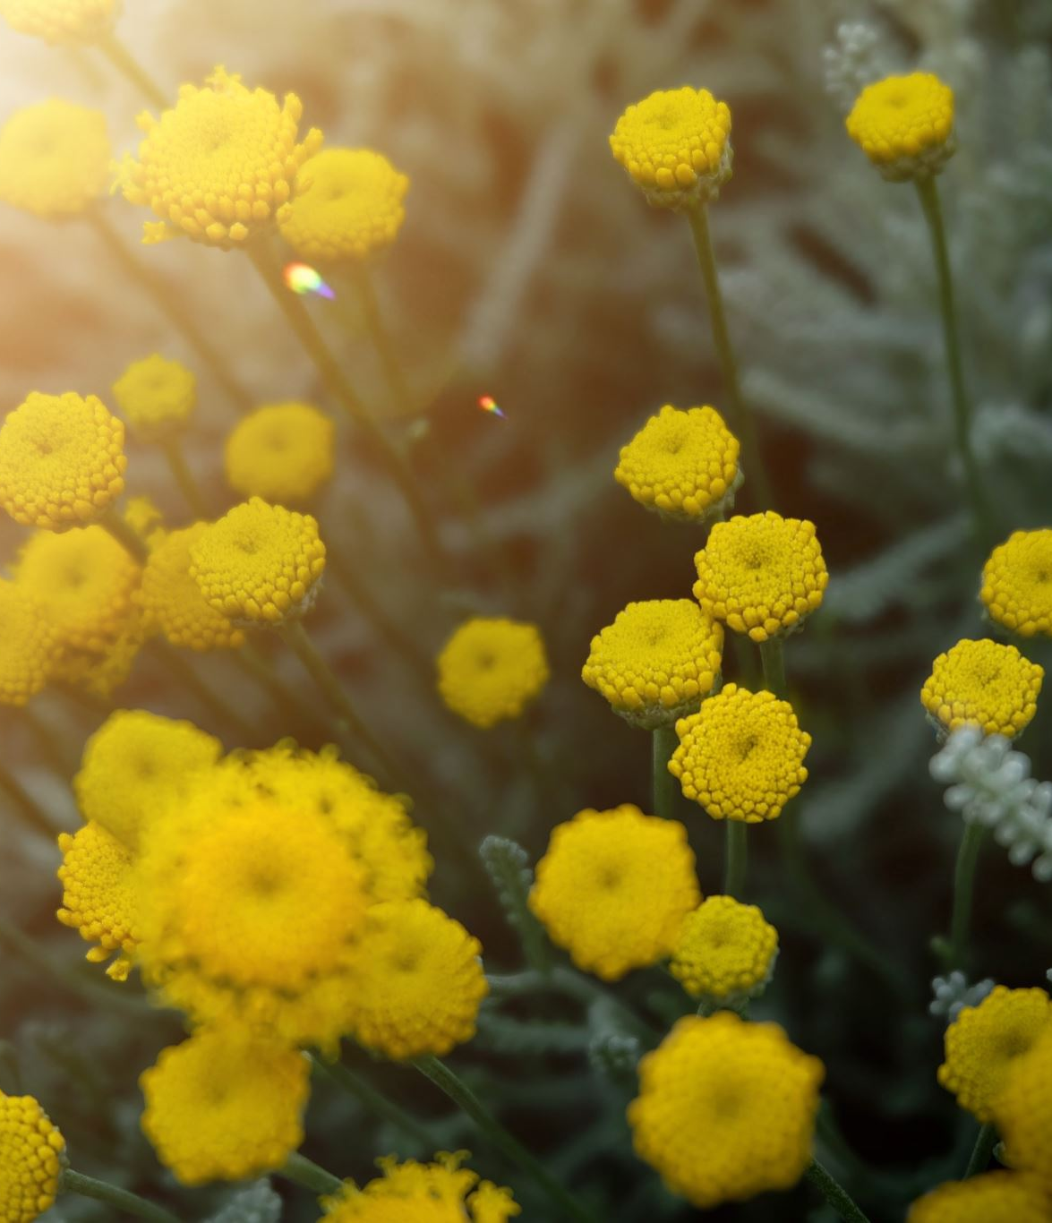
Types of Flowers
1. Annuals: Complete their life cycle in one year.
2. Perennials: Live for multiple years.
3. Biennials: Complete their life cycle in two years.
4. Wildflowers: Grow naturally without cultivation.

Slide 5

Flower Colors and Their Meanings
Different colors of flowers carry different meanings:
Red: Love and passion.
Yellow: Friendship and joy.
White: Purity and innocence.
Purple: Royalty and admiration.

Slide 6
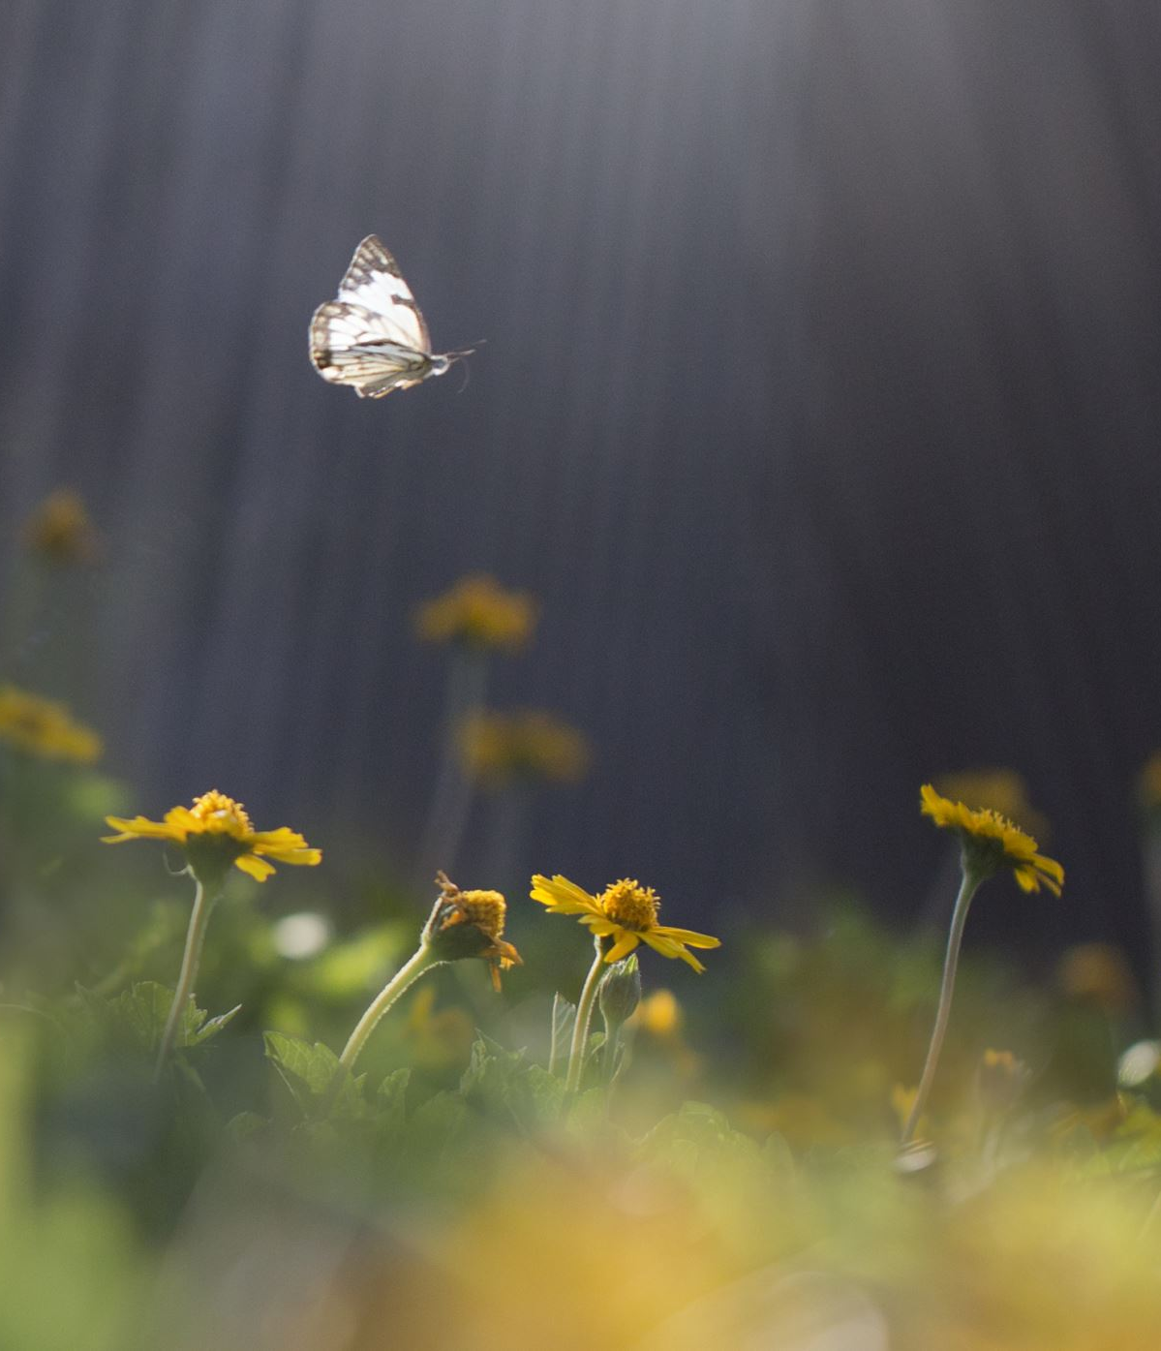
The Role of Pollinators
Pollinators, such as bees and butterflies, play a crucial role in the reproduction of flowers by:Transferring pollen between flowers.Supporting biodiversity.

Slide 7
Cultural Significance of Flowers
Flowers are important in many cultures:Used in weddings, funerals, and festivals.Symbolize emotions and are given as gifts.

Slide 8
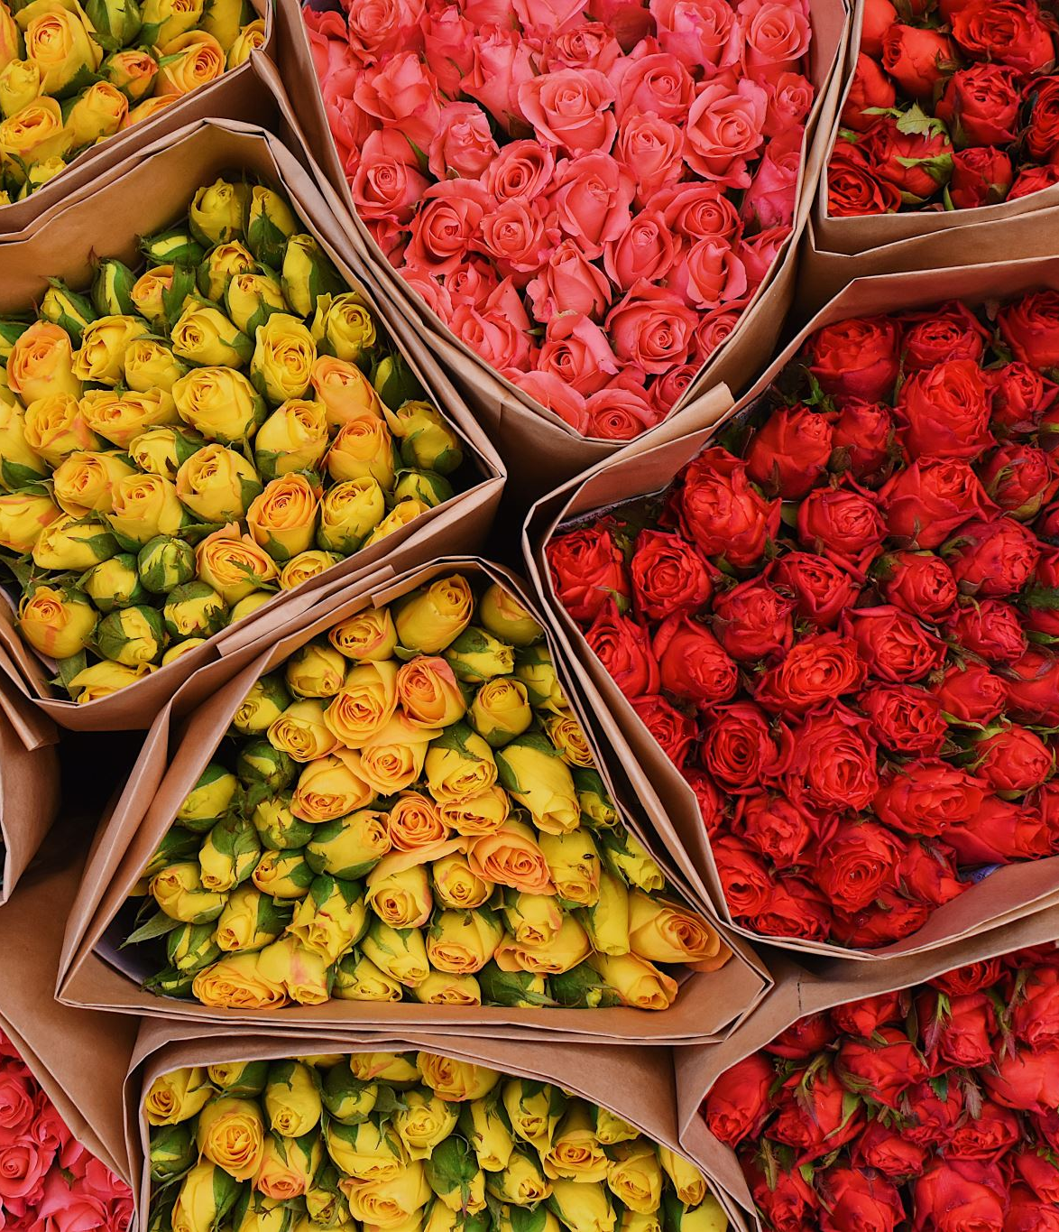
Economic Value of Flowers
The floral industry contributes significantly to the economy:Cut flowers: Sold in florists and markets.Ornamental plants: Grown for landscaping.Floral farming: Provides jobs and supports agriculture.

Slide 9
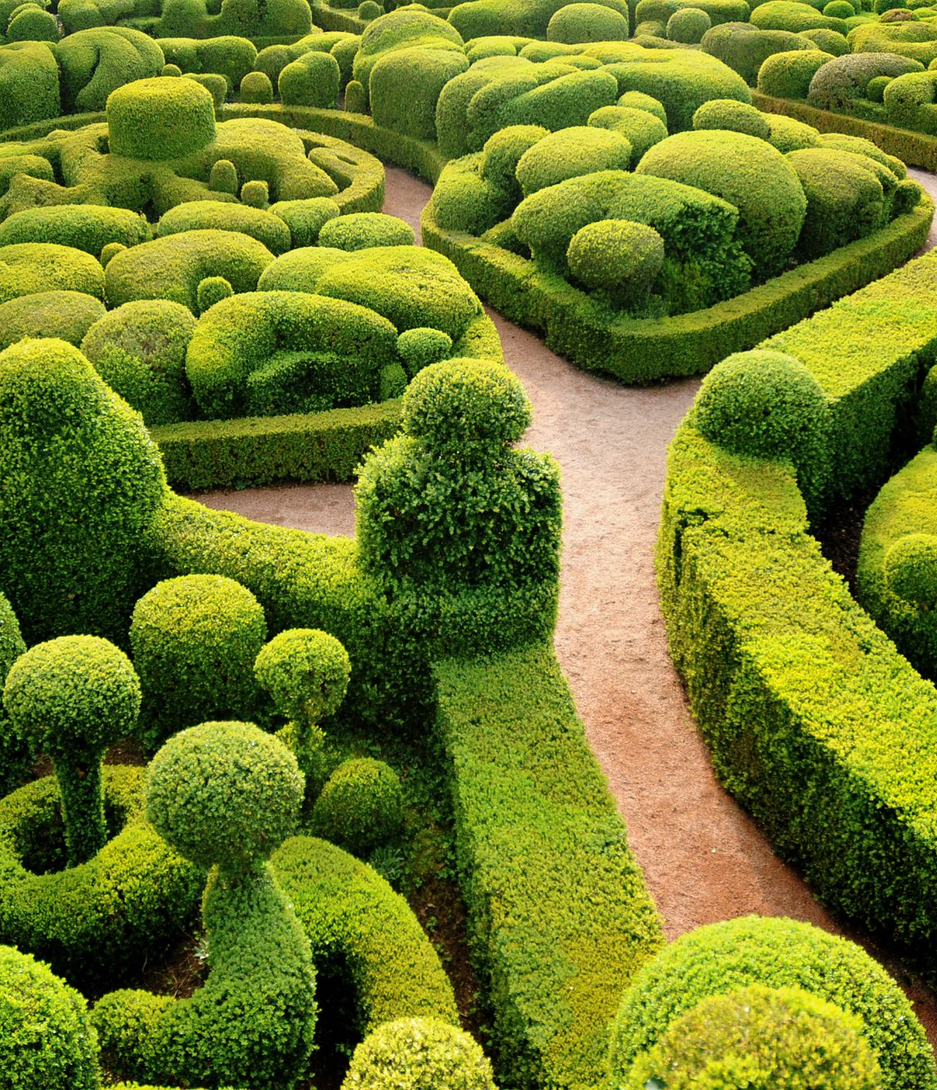
Famous Flower Gardens Around the World
1. Keukenhof, Netherlands: Known for tulips.
2. Butchart Gardens, Canada: Renowned for floral displays.
3. Gardens of Versailles, France: Historic and beautiful.

Slide 10
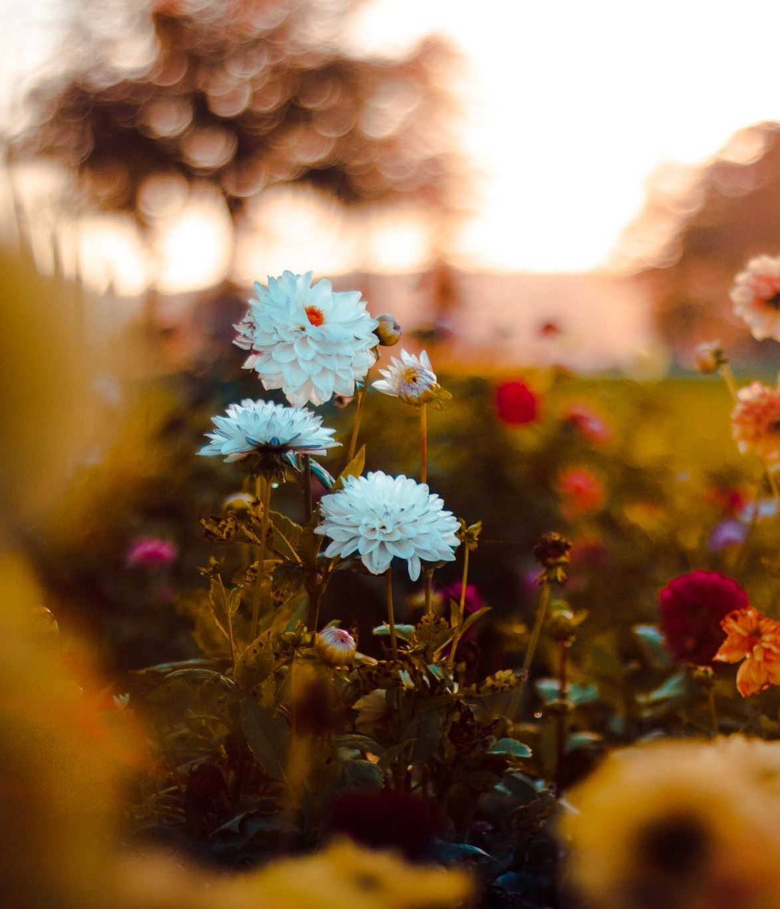
Environmental Benefits of Flowers
Flowers contribute to environmental health by:Supporting pollinators.Enhancing biodiversity.Improving air quality.

Slide 11
Conclusion
Flowers are more than just beautiful; they are essential to our ecosystems and cultures.Appreciating their diversity enriches our connection to nature.

